Slide 1

Neural Networks and Deep Learning for Life Sciences and Health Applications
An introductory course about theoretical fundamentals, case studies and implementations in python and tensorflow

Slide 2
3 Ws
Who am I
Who are you (background, profile, previous experience, expectations)
How is this course is structured

Slide 3
Course Structure
17:15 – 18:00 – Lesson + Activities
18:00 – 18:15 – Pause ☺
18:15 – 19:00 – Lesson + Activities
19:00 – 19:15 – Pause ☺
19:15 – 20:00 – Lesson + Activities

Slide 4
Administration

Slide 5
Meeting times
Every Tuesday 17:15-20:00 – Please arrive at 17:00 so that we can start on time
Exact dates:
3.10 – Preparation course: Python and numpy 30.10 - Preparation course: Linear Algebra 6.11 13.11 20.11 27.11 4.12 11.12 Christmas Pause 15.1 22.1 (End Project) 29.1 (End Project) 5.2 (End Project)

Slide 6
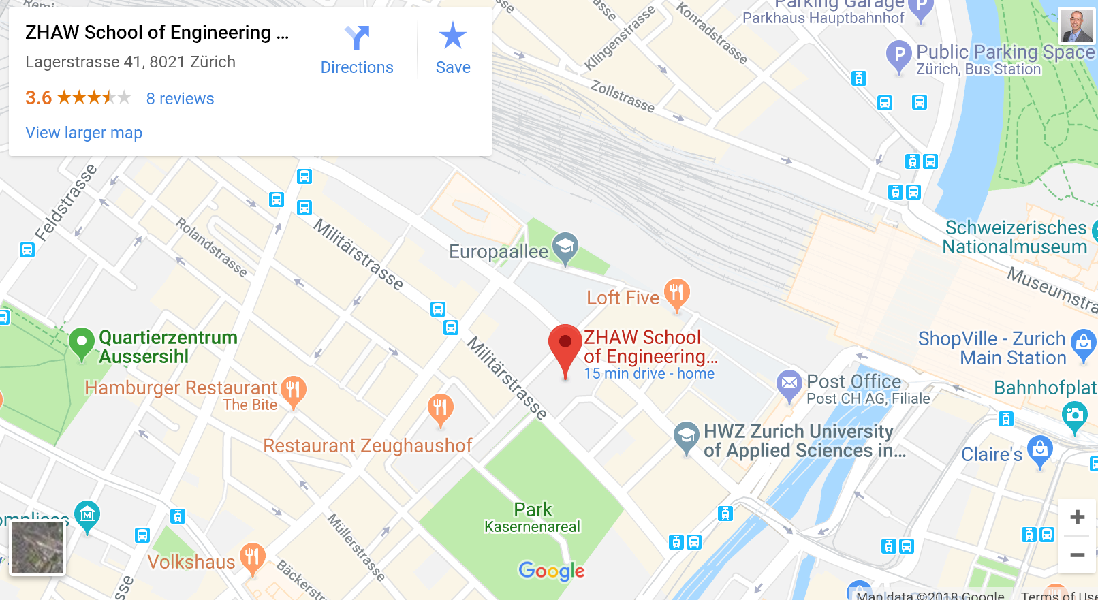
Location / Venue
We meet every Tuesday here
ZHAW Zürcher Hochschule für Angewandte Wissenschaften Lagerstrasse 41 8021 Zürich

Slide 7
How to contact me
Feel free to contact me anytime at umberto.michelucci@gmail.com with any kind of questions. I will answer each and every email I will receive.
If is really urgent you can get in touch with me by phone: 079 396 7406. You can find me also on whatsapp.

Slide 8
Where to find the slides/code examples/material

Slide 9
github
You will find everything on github at this link
https://github.com/michelucci/dlcourse2018_students
(or if you want to type it https://goo.gl/CgDbUH)
On github you will find all power point presentations, all jupyter notebooks and all datasets that we will use during this course.

Slide 10
Which Tools / Technologies are we using in this course?
In this course we will use:
Files management system: github.com
Programming language: python (anaconda distribution: https://conda.io/docs/user-guide/install/download.html)
Development environment: Jupyter notebooks
Python packages: numpy / matplotlib / (less frequently) pandas
Python deep learning package: tensorflow
Each need to use his/her own laptop (windows or mac will work)

Slide 11
How to setup your environment
Check Chapter 1 of book to see how to setup your development environment. In case you need help let me know by email or in person.

Slide 12
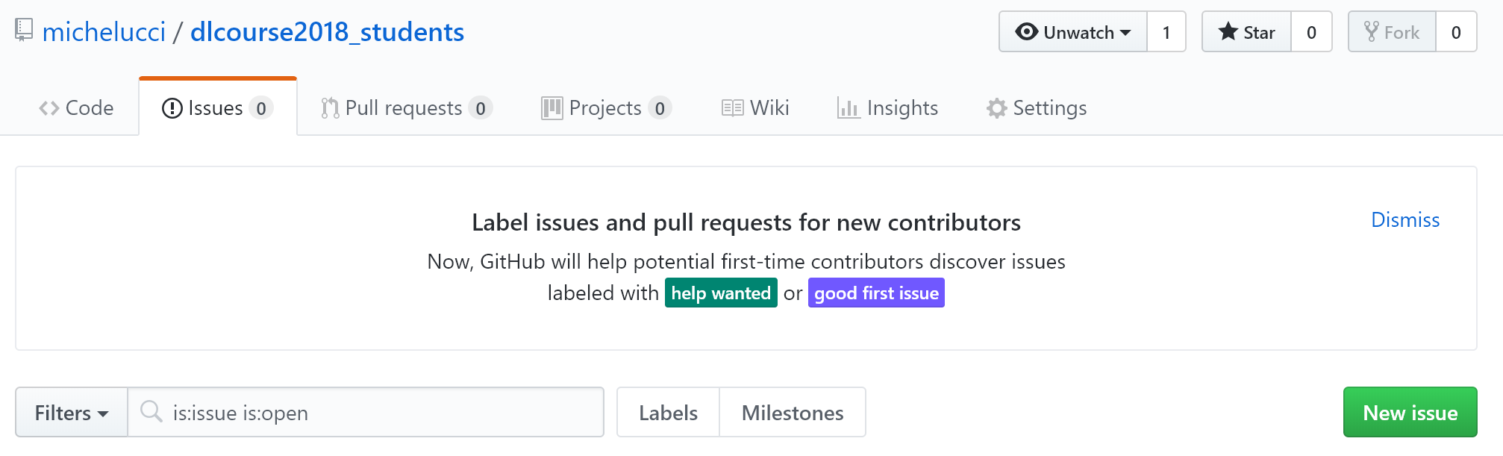
How to send me errors and requests
I am not perfect so the probability that you will find errors in the powerpoint presentations or (especially) in the code exampels (the jupyter notebooks) is not zero. In case you do, please send me the bugs. To make the bugs easier to correct (for me) and easier to check (for you) please use the «New Issue» functionality in github (see following slides to see how)

Slide 13
How to create an issue in github
To learn how to create a bug in github you can follow this easy guide from github
https://help.github.com/articles/creating-an-issue/
(or if you want to type https://goo.gl/294qg4)

Slide 14
How to create an issue in github - DEMO

